Slide 1
CS2S567 Personal Information Management (Team 2) Phase 1
By
Fatoumata Makalo, dennis ofasi ,
nisa shahril and Gloria peter zacharia

Slide 2
Introduction
Our project is to create a personal information management system with a Graphical User Interface.
We will talk about the different aspects of the first phase of this project.
Notes:
Dennis: We are creating a personal information system which will have a graphical user interface. We will also show with you some of the actions we took to accomplish our short term goals.

Slide 3
Goal of the Personal Information Management
The goal of our part of the project is to design and create a user friendly GUI that will store personal information. Users will be able to view employee details, store and update personal information within the company.
Notes:
Fatima

Slide 4
Planning phase
Role allocation
Team communication
The Design of the GUI
The flowchart
The Pseudocode
Quality Assurance
Policy document
Notes:
Dennis: There were a few things we had to sort out as team before we could begin planning. We first had to allocate different tasks within the team. I was scrum master and was also focusing on the policy documentation for the information system.
Nisa (Team Communication and organisation): Explain importance of communication between teammates.
Gloria (Flowchart and Pseudocode):
Fatima (Quality Assurance):
Dennis (Policy Document): I was responsible for creating a policy document for the information system. I did some research on policy documents and how I could write it.

Slide 5
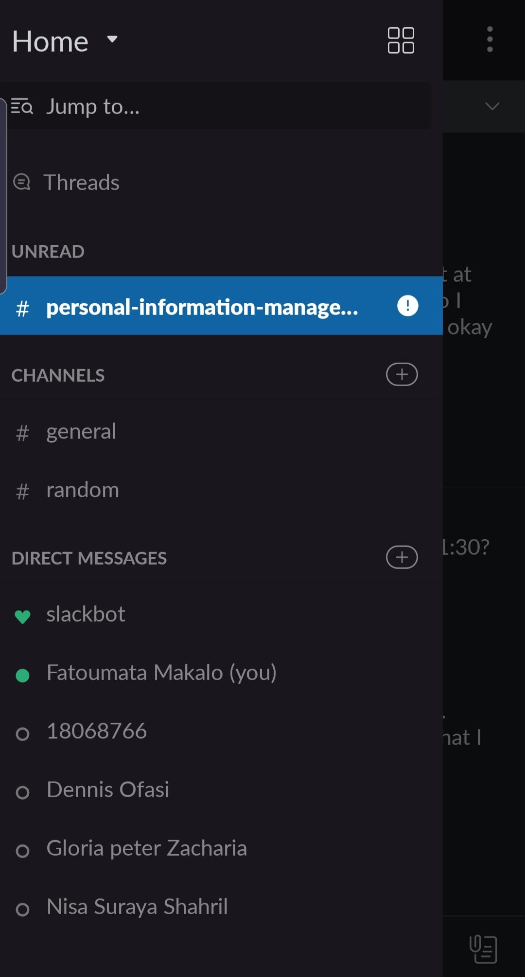
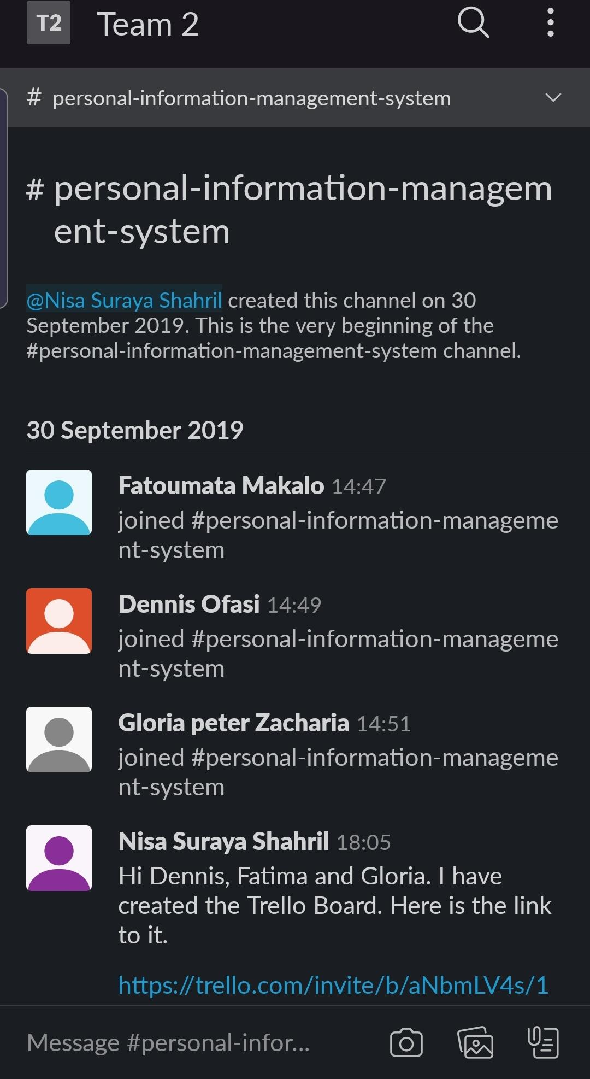
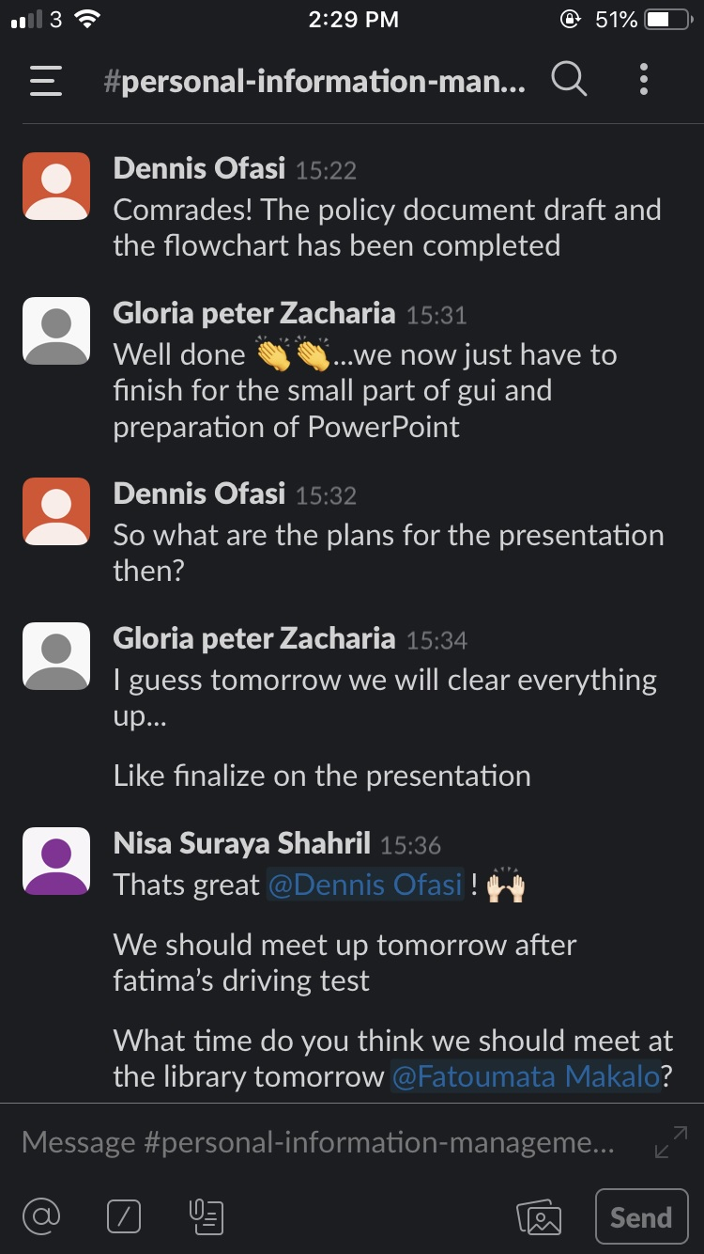
Slack
Notes:
Nisa: We chose Slack as our main medium to communicate between us teammates.

Slide 6
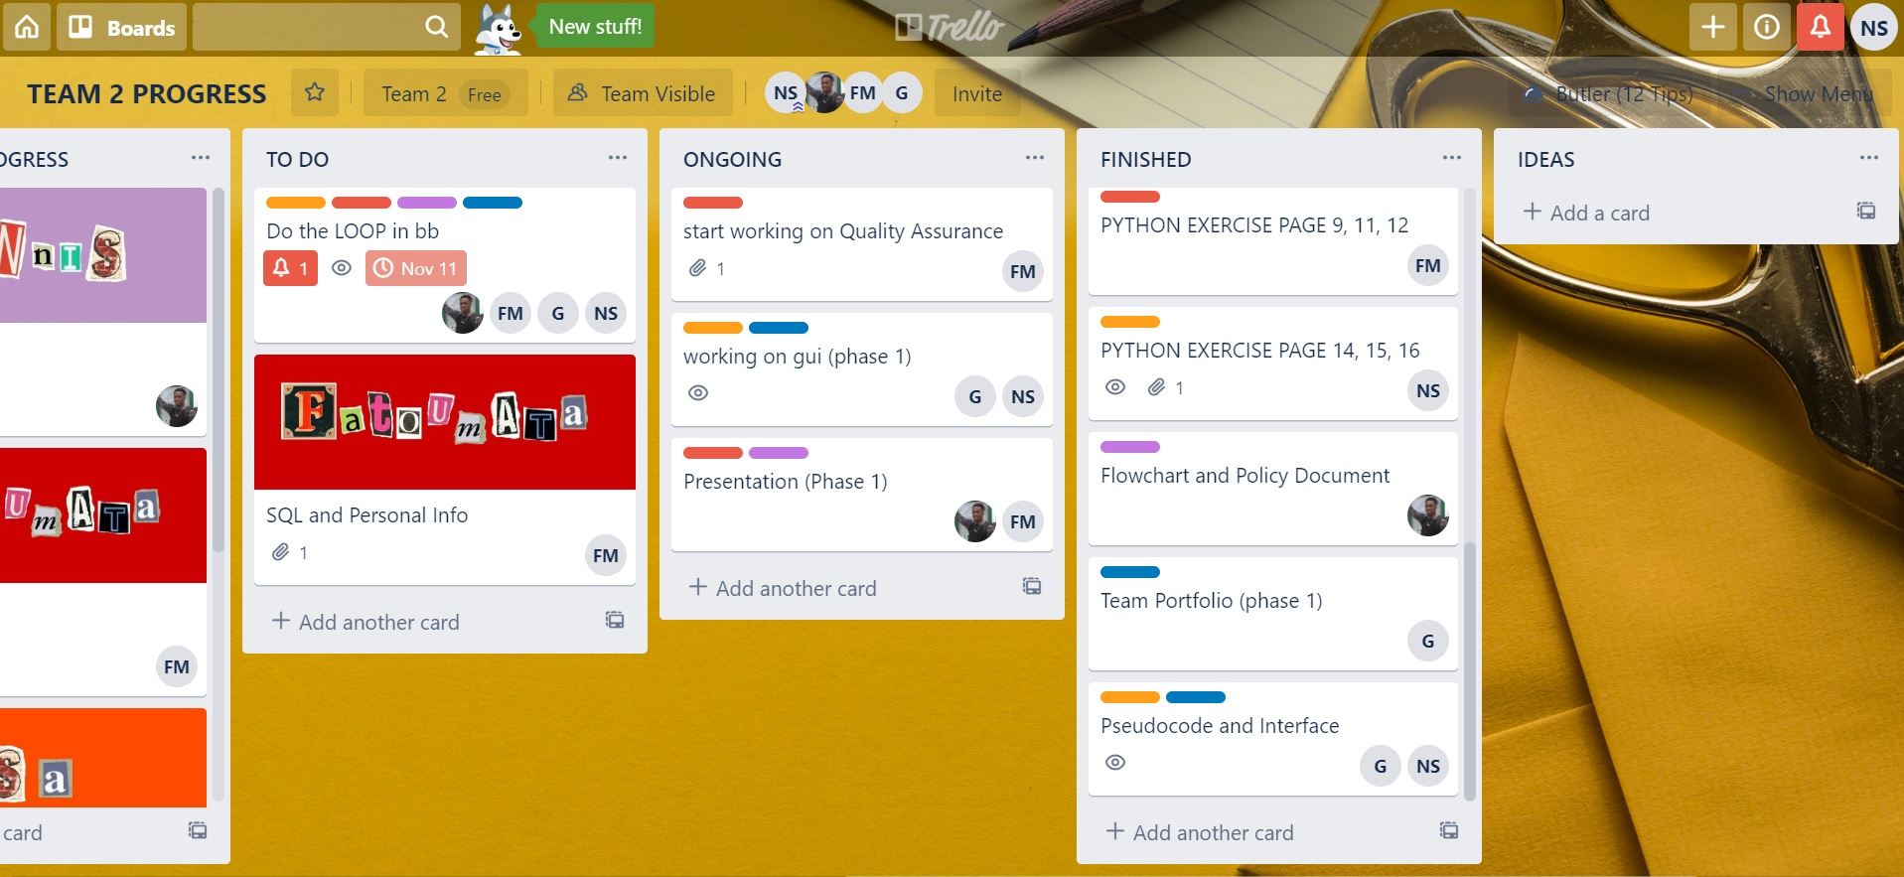
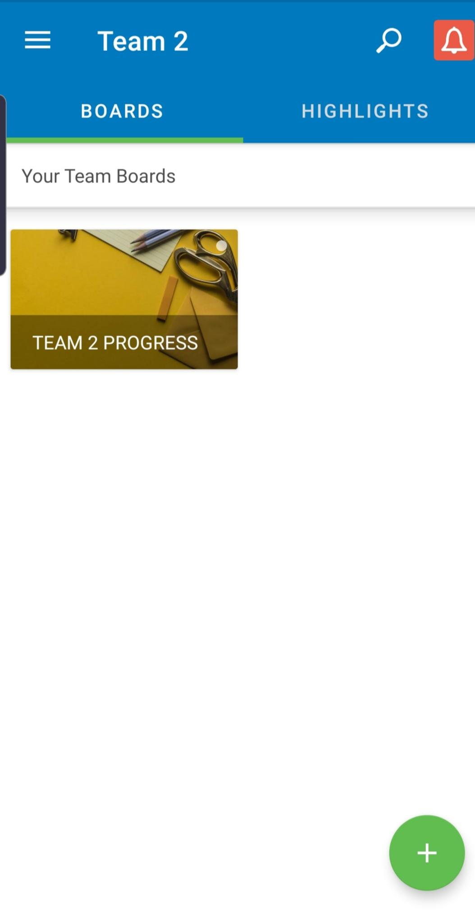
Trello
Notes:
Nisa: We update our Trello Board very frequently and decided to refer to it for our progression throughout the first 9 weeks.

Slide 7
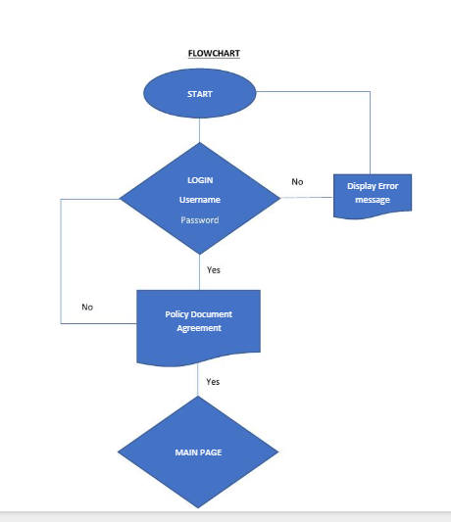
Flowchart
Notes:
Gloria:

Slide 8
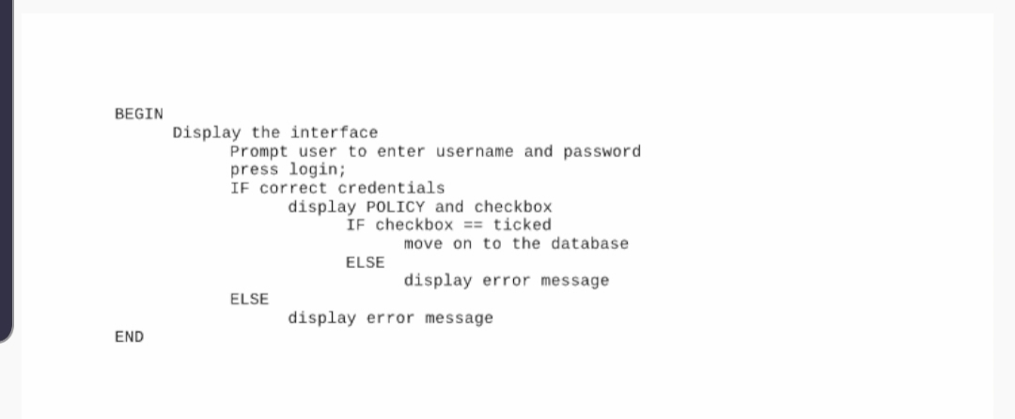
Pseudo code
Notes:
Gloria:

Slide 9
Quality Assurance
The purpose of our QA document is to outline tasks. This will help us;
To approve, review and update tasks within different phase of the project.
Specifications:
The GUI will have a homepage.
User will be directed to the Account Login (Username and Password).
Username and Password will have restricted Access
A policy check to accept before login
Notes:
Fatima:

Slide 10
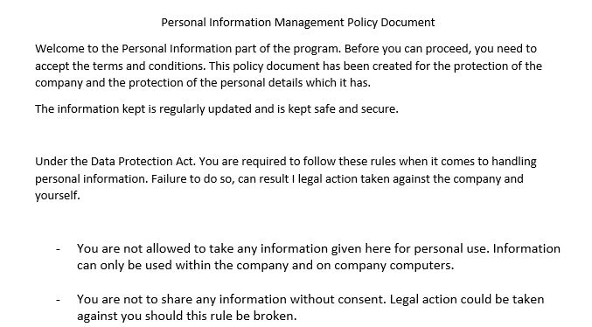
Policy Document
Notes:
Dennis:

Slide 11
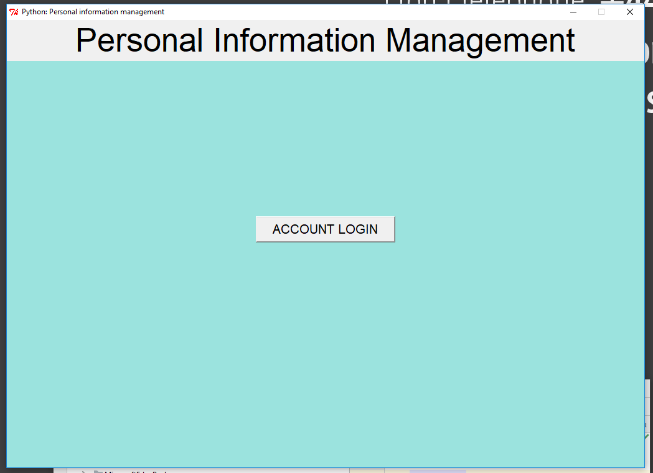
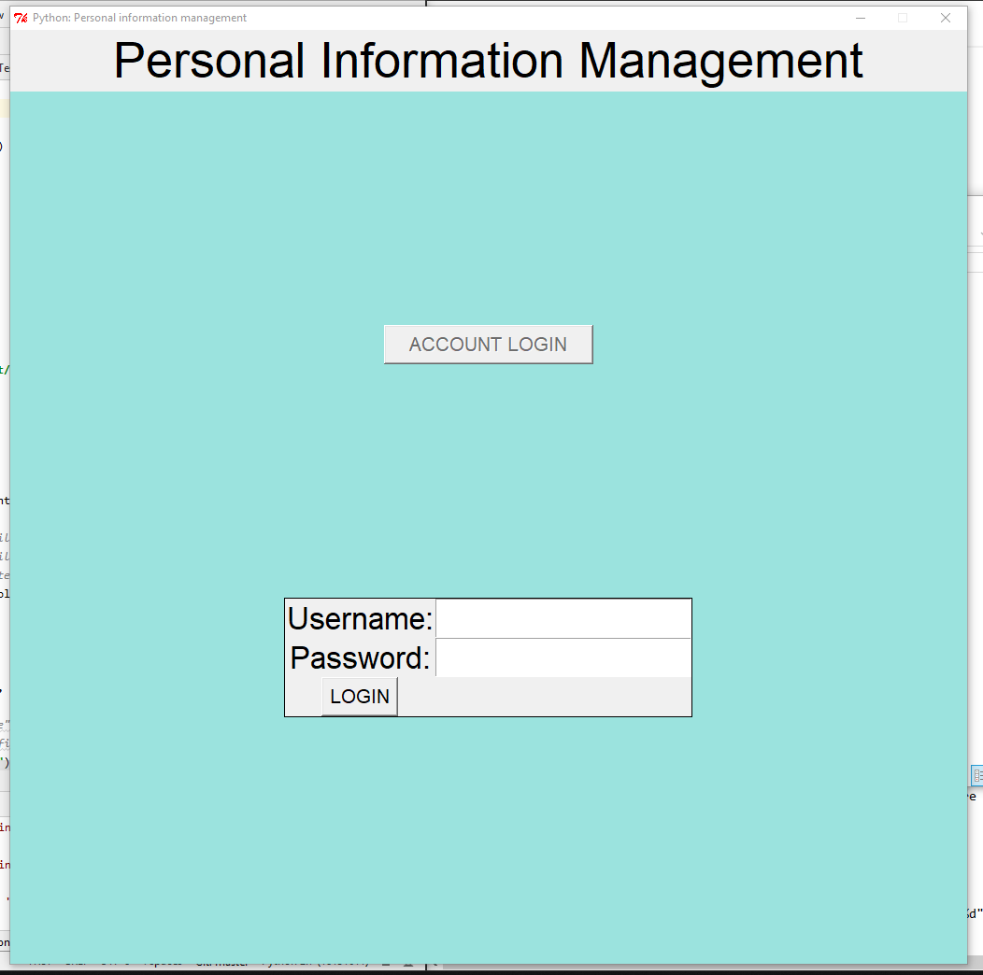
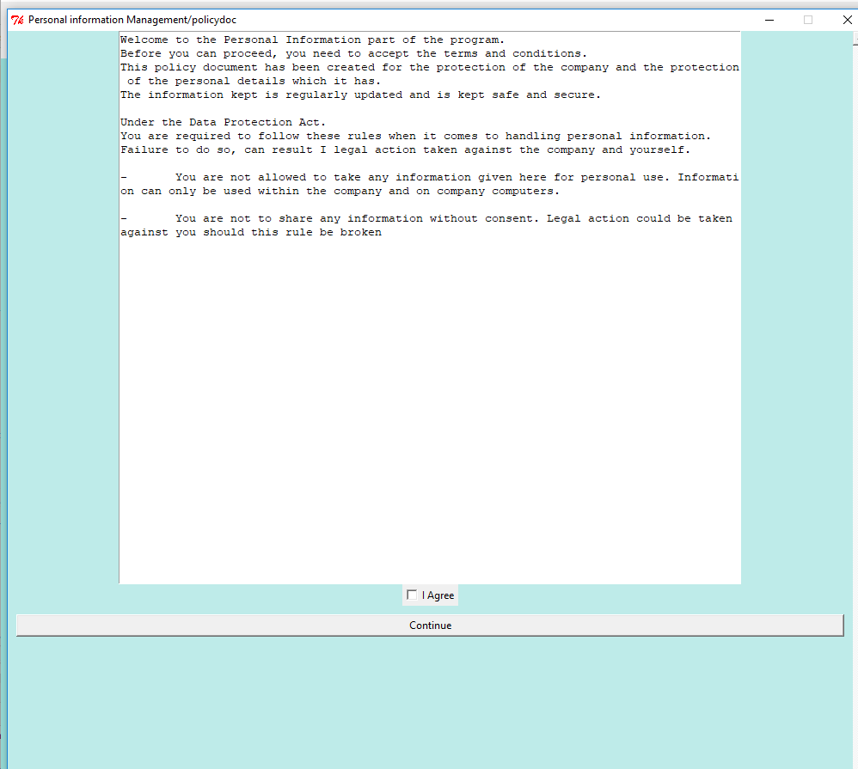
Graphical User Interface
1. Home
2. Account Login
3. Policy Document

Slide 12
Future scope
Move on to a the second phase
Work on the GUI
Notes:
Fatima:

Slide 13
Questions
Thanks for listening
Do any of you have a questions?
Or suggestions?

